Slide 1
3
Matrices

Slide 2
3.2
Matrix Algebra

Slide 3
Properties of Addition and Scalar Multiplication

Slide 4
Properties of Addition and Scalar Multiplication (1 of 4)
Theorem 3.2
Algebraic Properties of Matrix Addition and Scalar Multiplication
Let A, B, and C be matrices of the same size and let c and d be scalars. Then
a. A + B = B + A Commutativity
b. (A + B) + C = A + (B + C) Associativity
c. A + O = A

Slide 5
Properties of Addition and Scalar Multiplication (2 of 4)
d. A + (− A) = O
e. c(A + B) = cA + cB Distributivity
f. (c + d)A = cA + dA Distributivity
g. c(dA) = (cd)A
h. 1A = A

Slide 6
Properties of Addition and Scalar Multiplication (3 of 4)
We can define the span of a set of matrices to be the set of all linear combinations of the matrices.

Slide 7
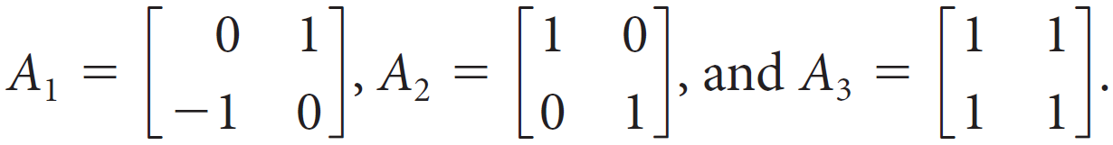
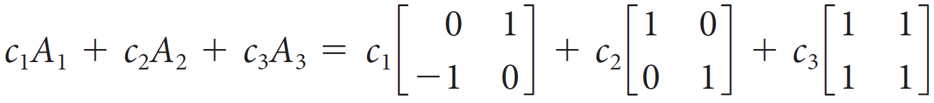
Example 3.17
Describe the span of the following matrices.
Solution:
One way to do this is simply to write out a general linear combination of A₁, A₂, and A₃. Thus,

Slide 8
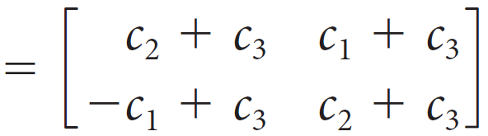
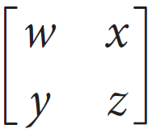
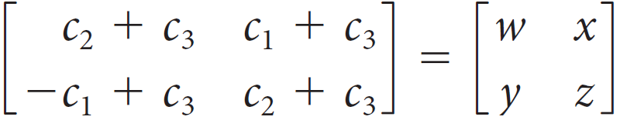
Example 3.17 – Solution (1 of 3)
(which is analogous to the parametric representation of a plane). But suppose we want to know when the matrix
is in span (A₁, A₂, A₃). From the representation
above, we know that it is when
for some choice of scalars c₁, c₂, c₃.

Slide 9
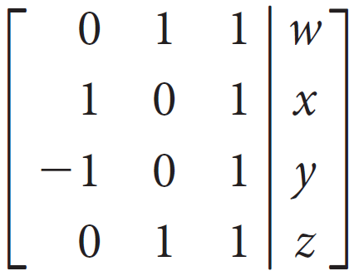
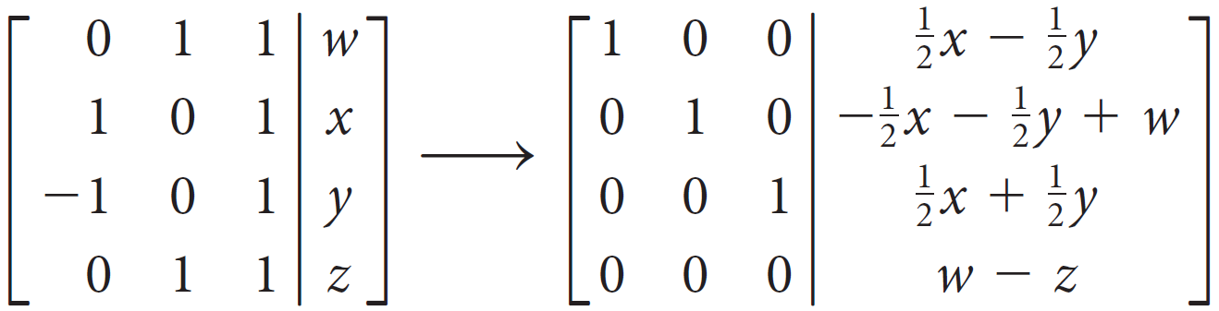
Example 3.17 – Solution (2 of 3)
The augmented matrix of this system is
and row reduction produces

Slide 10
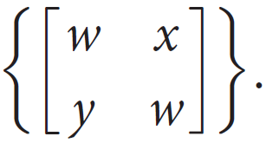
Example 3.17 – Solution (3 of 3)
Check: The only restriction comes from the last row, where clearly we must have w − z = 0 in order to have a solution. Thus, the span of A₁, A₂, and A₃ consists of all matrices
for which w = z. That is, span(A₁, A₂, A₃) =

Slide 11
Properties of Addition and Scalar Multiplication (4 of 4)
Note
Linear independence also makes sense for matrices. We say that matrices A₁, A₂, ... , A_{k} of the same size are linearly independent if the only solution of the equation
c₁A₁ + c₂A₂ + ... + c_{k}A_{k} = O (1)
is the trivial one: c₁ = c₂ = ... = c_{k} = 0. If there are nontrivial coefficients that satisfy (1), then A₁, A₂, . . . , A_{k} are called linearly dependent.

Slide 12
Properties of Matrix Multiplication

Slide 13
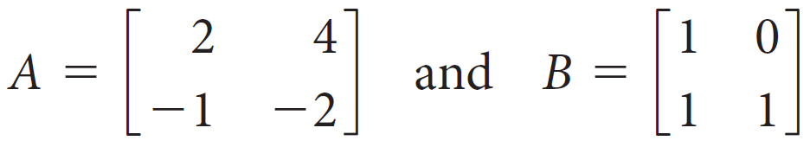
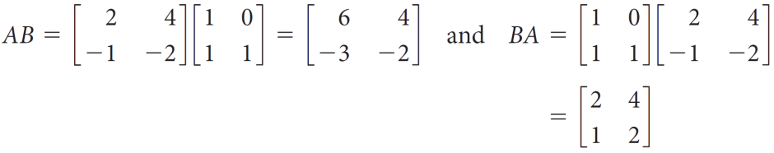
Example 3.19 (1 of 2)
Consider the matrices
Multiplying gives

Slide 14
Example 3.19 (2 of 2)
Thus, AB ≠ BA. So, in contrast to multiplication of real numbers, matrix multiplication is not commutative—the order of the factors in a product matters!

Slide 15
Properties of Matrix Multiplication (1 of 1)
Theorem 3.3
Properties of Matrix Multiplication
Let A, B, and C be matrices (whose sizes are such that the indicated operations can be performed) and let k be a scalar. Then
a. A(BC) = (AB)C Associativity
b. A(B + C) = AB + AC Left distributivity
c. (A + B)C = AC + BC Right distributivity
d. k(AB) = (kA)B = A(kB)
e. I_{m}A = A = AI_{n} if A is m × n Multiplicative identity

Slide 16
Properties of the Transpose

Slide 17
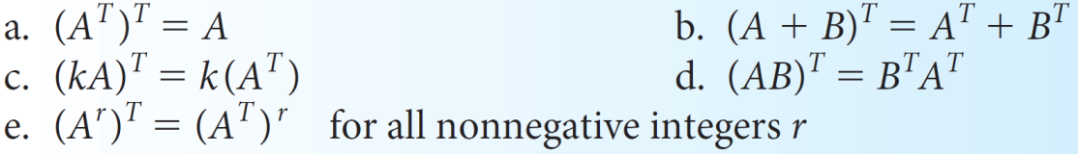
Properties of the Transpose (1 of 2)
Theorem 3.4
Properties of the Transpose
Let A and B be matrices (whose sizes are such that the indicated operations can be performed) and let k be a scalar. Then

Slide 18
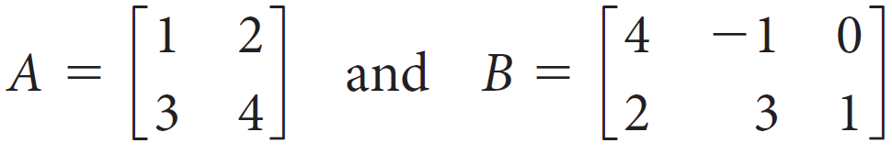
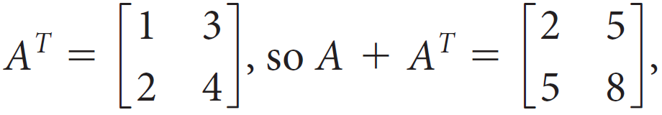
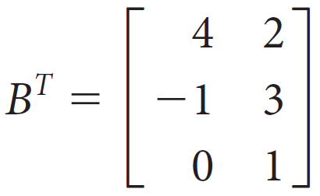
Example 3.21 (1 of 2)
Let
Then
a symmetric matrix.
We have

Slide 19
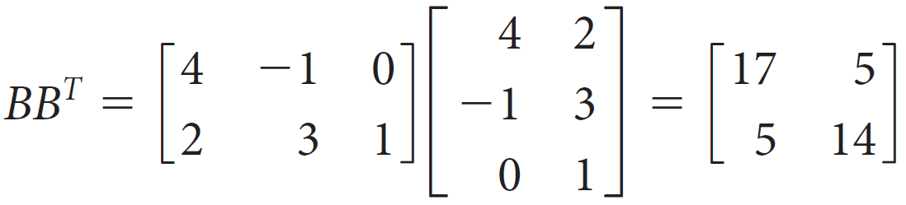
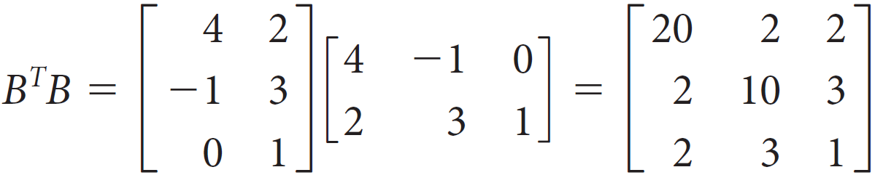

Example 3.21 (2 of 2)
so
and
Thus, both
are symmetric, even though B is not even square!

Slide 20


Properties of the Transpose (2 of 2)
Theorem 3.5
a. If A is a square matrix, then
is a symmetric matrix.
b. For any matrix A,
are symmetric matrices.

